Slide 1
Java 8 Feature Preview
Mostly about Lambdas

Slide 2
New Feature Overview
Roughly 50 new features
Worth mentioning
Concurrency updates (possible STM support)
JDBC 4.2 – leverage new data types via generic getter / setter methods (e.g. JSR 310 datatypes)
Launch JavaFX apps directly
http://openjdk.java.net/projects/jdk8/features has full details

Slide 3

Forward Looking Statement

Slide 4
Download JDK 8
Lambda Support http://jdk8.java.net/lambda
No Lambda Support http://jdk8.java.net/download.html

Slide 5
IDE Support
Netbeans
IntelliJ
Eclipse is on the way (own compiler)

Slide 6
Maven Support
<plugin>
<groupId>org.apache.maven.plugins</groupId>
<artifactId>maven-compiler-plugin</artifactId>
<version>2.3.2</version>
<configuration>
<source>1.8</source>
<target>1.8</target>
</configuration>
</plugin>

Slide 7
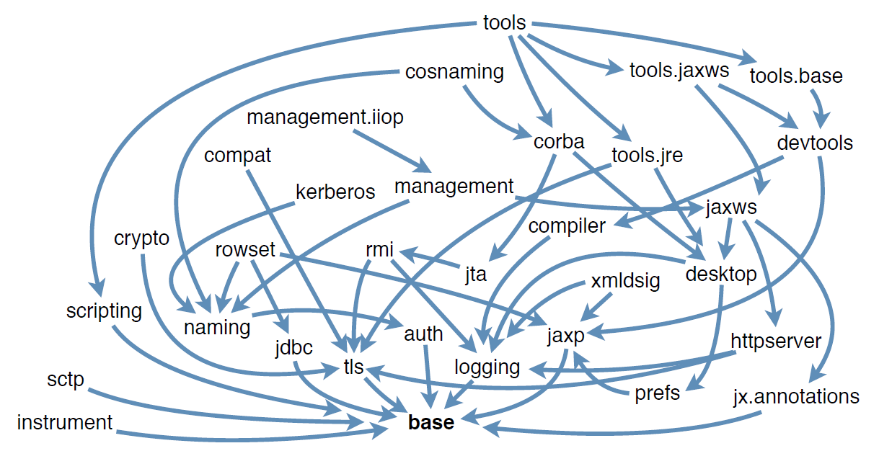
Before Compact Profiles (from Leader Summit –see http://www.hjug.org/present/iouc2013/2013-Java-Leaders-Summit-JavaSE.pdf)

Slide 8
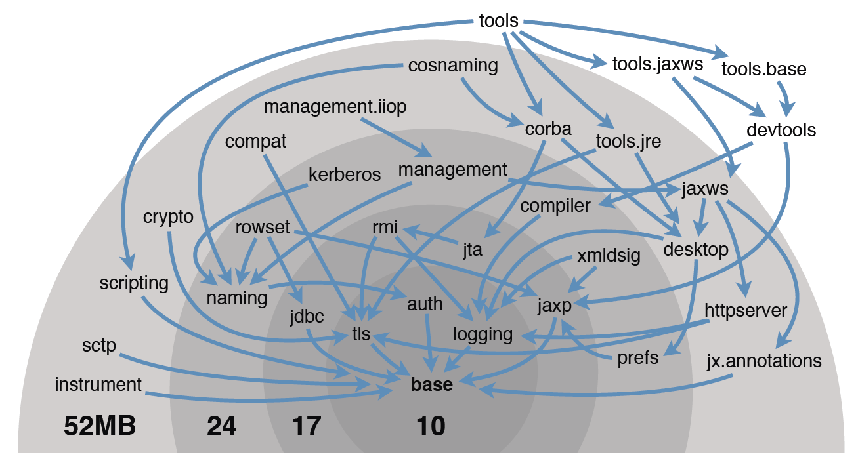
Compact Profiles (from Leader Summit –see http://www.hjug.org/present/iouc2013/2013-Java-Leaders-Summit-JavaSE.pdf)

Slide 9
Nashorn
Replacement for Rhino JavaScript Engine
Collaboration between Oracle, IBM, and RedHat
Makes extensive use of invokedynamic
20x faster than Rhino
Much smaller - can run on embedded devices
Open Sourced
Project Page: http://openjdk.java.net/projects/nashorn/

Slide 10
Metaspace
Bye bye PermGen
Holds class metadata
Introduced for convergence with JRockit
MetaSpace OoMEs can happen (when capped)
Initial size limited by amt of native memory
May want to update tuning flags

Slide 11
JSR 310 – java.time
All the Java Time classes are immutable and thread-safe.
Based on the ISO 8601 calendar system, the de facto world calendar following the proleptic Gregorian Rules.
Support for other calendar systems provided in java.time.calendar and java.time.temporal packages.
Besides classes for dates and times, the API also has classes for clocks, periods and durations, and enums for month and day-of-week.

Slide 12

Lambdas

Slide 13
Lambdas
A lambda expression is like a method: it provides a list of formal parameters and a body—an expression or block—expressed in terms of those parameters.
Expressions:
s -> s.length()
(int x, int y) -> x+y
() -> 42

Slide 14
Lambdas
Blocks:
(x, y, z) -> { if (true) return x; else { int result = y; for (int i = 1; i < z; i++) result *= i; return result; } }

Slide 15
Typical Use Cases
Anonymous classes (GUI listeners)
Runnables / Callables
Comparator
Apply operation to a collection via foreach method

Slide 16
SAM Type / Functional Interface
Single Abstract Method
A functional interface is an interface that has just one abstract method, and thus represents a single function contract. (Can have other methods with bodies)
Abstract classes may be considered in the future
The @FunctionalInterface annotation helps ensure the Functional Interface contract is honored
What happens when you have more than one abstract method & use @FunctionalInterface?

Slide 17
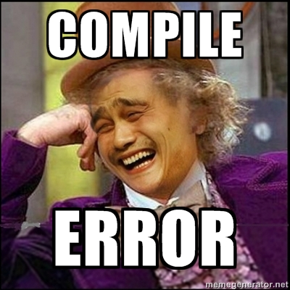

Slide 18
Effectively Final
For both lambda bodies and inner classes, local variables in the enclosing context can only be referenced if they are final or effectively final.
A variable is effectively final if it is never assigned to after its initialization.
No longer need to litter code with final keyword

Slide 19
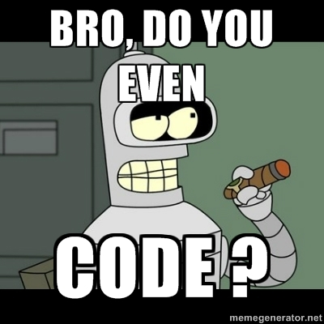

Slide 20
Convert Anonymous Class to Lambda from http://learnjavafx.typepad.com/weblog/2013/02/mary-had-a-little-%CE%BB.html
// Anonymous inner class for event handling .onAction(new EventHandler<ActionEvent>() { @Override public void handle(ActionEvent e) { anim.playFromStart();
}
})

Slide 21
Convert Anonymous Class to Lambda
.onAction((ActionEvent) -> { anim.playFromStart();
}
})
The lambda type is inferred by the compiler as EventHandler<ActionEvent> because the onAction() method takes an object of type EventHandler<ActionEvent>.

Slide 22
Convert Anonymous Class to Lambda
.onAction((e) -> {
anim.playFromStart();
})
The parameter in this lambda expression must be an ActionEvent, because that is the type specified by the handle() method of the EventHandler interface.

Slide 23
Convert Anonymous Class to Lambda
.onAction(e -> {
anim.playFromStart();
} )
When a lambda expression has a single parameter and its type is inferred, the parentheses are not required

Slide 24
Convert Anonymous Class to Lambda
.onAction(e -> anim.playFromStart())
Because the block of code in our lambda expression contains only one statement, we can simplify it even further

Slide 25
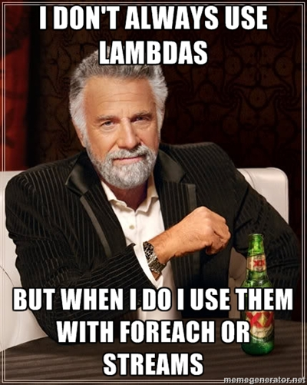

Slide 26
forEach
forEach method available on Iterator & Map interfaces and their implementations
Allows for internal control of iteration of elements for possible parallel operation
List<String> names = Arrays.asList("Alice", "Bob", "Charlie");
names.forEach(e -> { System.out.println(e); });

Slide 27
java.util.stream Classes to support functional-style operations on streams of values
Stream<T> - A sequence of elements supporting sequential and parallel bulk ops
Stream opened by calling
Collection.stream()
Collection.parallelStream()
List<String> names =
Arrays.asList("Bob", "Alice", "Charlie");
out(names.stream().filter(e -> e.length() > 4 ) .findFirst().get());
Returns “Alice”

Slide 28
java.util.stream
All other interfaces in stream package accessible through Stream interface
Collector<T,R> - A (possibly parallel) reduction operation that folds input elements into a mutable result container.
FlatMapper<T,U> - An operation that maps an element of type T to zero or more elements of type U.

Slide 29
java.util.function Functional interfaces provide target types for lambda expressions and method references.
Consumer<T> - An operation which accepts a single input argument and returns no result.
Function<T,R> - Apply a function to the input argument, yielding an appropriate result.
Supplier<T> - A supplier of objects.
Predicate<T> - Determines if the input object matches some criteria.
Unary/BinaryOperator<T> - An operation upon a single / two operand(s) yielding a result.
Bi(Consumer/Function/Predicate)<T,U(,R)> - Accepts two input arguments, yields result if specified

Slide 30
java.util
Spliterator<T> - A provider of element traversal operations for a possibly-parallel computation.
Optional<T> - A container object which may or may not contain a non-null value
Returned by Stream’s aggregate methods
find*(), reduce(), min(), max()
Call get() to get the value it’s holding

Slide 31
Method & Constructor References
A method reference is used to refer to a (static or instance) method without invoking it
A constructor reference is similarly used to refer to a constructor without creating a new instance of the named class or array type.
Specified with the :: (double colon) operator

Slide 32
Method & Constructor References
Provide a way to refer to a method / constructor without invoking it
Examples:
System::getProperty
"abc"::length
String::length
super::toString
ArrayList::new
int[]::new

Slide 33


Slide 34
Convert call to Method Reference
public class Test {
static void foo(){}
static {
new Runnable() {
@Override
public void run() {
Test.foo();
}
}.run();
}
}

Slide 35
Convert call to Method Reference
public class Test {
static void foo(){}
static {
((Runnable) () -> Test.foo()).run();
}
}

Slide 36
Convert call to Method Reference
public class Test {
static void foo(){}
static {
((Runnable) Test::foo()).run();
}
}

Slide 37
Use a Method Reference
bttnExit.setOnAction((actionEvent) -> {
try {
stop();
} catch (Exception e) {
// TODO: add error handling
} });
Can be
void onExitButtonClick() {
try {
stop();
} catch (Exception e) {
// TODO: add error handling
}
}
...
bttnExit.setOnAction(this::onExitButtonClick);

Slide 38
Use a Constructor Reference
interface Factory<T> { T make(); } Factory<List<String>> f1 = ArrayList::<String>new;
Every time make() is invoked, it wil return a new ArrayList<String>

Slide 39
How many times have you heard

Slide 40
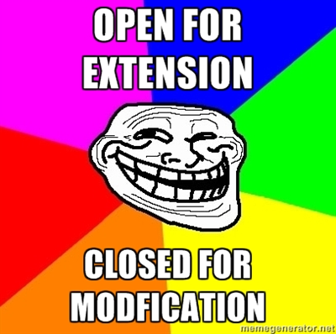

Slide 41
Whatever!
Method assigned to privileged interface:
public class Main { public static class NotAutoCloseable { public void close() throws Exception { System.out.println("CLOSE"); } } public static void main(String... args) throws Exception { NotAutoCloseable nac = new NotAutoCloseable(); try (AutoCloseable ac = nac::close) { } } }

Slide 42
Interface Defender Methods
Interface methods with bodies
default keyword
More graceful API evolution
Interfaces have no state
Static methods not inherited
Can reference abstract method
Called “Extended Interfaces” if no abstract methods present

Slide 43
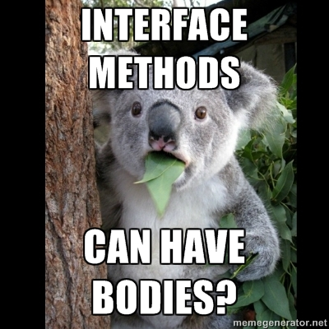

Slide 44
Super!
Extended Interfaces can extend other extended interfaces
Methods can be overridden
Can decorate parent definitions via super
interface I1 { default void method1() {//do stuff}}
interface I2 extends I1{
void default method1() {
super.method1();
//do new stuff
}
}

Slide 45
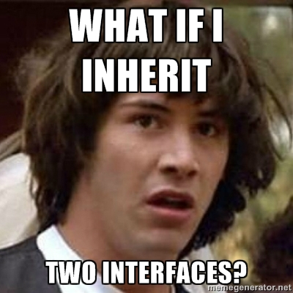

Slide 46
Specify the Parent Interface
interface D1 { default void meth1() {//do stuff}}
interface D2 extends D1{ void default meth1() {
super.method1(); //do new stuff}}
interface D3 extends D1{ void default meth1() {
super.method1(); //do new stuff}}
interface D4 extends D2, D3{
void default meth1() {
D2.super.method1(); //do new stuff}}

Slide 47
Design Patterns
Decorator (via super)
Template Method
Factory Method
Others?

Slide 48
New Java 8 Feature Overview
http://openjdk.java.net/projects/jdk8/features
http://java.dzone.com/articles/java-%E2%80%93-far-sight-look-jdk-8
Java 8 Maven Support
http://illegalargumentexception.blogspot.com/2012/08/java-lambda-support-in-java-8.html
DateTime API
http://www.infoq.com/news/2013/02/java-time-api-jdk-8
http://java.dzone.com/articles/introducing-new-date-and-time
http://geekmonkey.org/articles/24-a-new-date-and-time-api-for-jdk-8
Metaspace
http://java.dzone.com/articles/java-8-permgen-metaspace
Nashorn
http://www.infoq.com/news/2012/11/Nashorn-proposal

Slide 49
Lambda JSR
http://jcp.org/en/jsr/detail?id=335
Java 8 Preview JDK
http://jdk8.java.net/lambda/ - lambda support
http://jdk8.java.net/download.html - no lambda support
Articles on Lambdas
http://www.oraclejavamagazine-digital.com/javamagazine/20121112?pg=35#pg35
http://www.angelikalanger.com/Conferences/Slides/jf12_LambdasInJava8-1.pdf
http://datumedge.blogspot.com/2012/06/java-8-lambdas.html
http://www.infoq.com/articles/java-8-vs-scala
Presentations on Lambdas:
http://www.slideshare.net/ramonypp/java-8-project-lambda
http://www.slideshare.net/garthbrown/lambda-functions-in-java-8
http://www.angelikalanger.com/Conferences/Slides/jf12_LambdasInJava8-1.pdf
Lambda implementation mechanics:
http://cr.openjdk.java.net/~briangoetz/lambda/lambda-translation.html

Slide 50
Typical lambda use cases:
http://learnjavafx.typepad.com/weblog/2013/02/mary-had-a-little-%CE%BB.html
http://blueskyworkshop.com/topics/Java-Pages/lambda-expression-basics/
http://java.dzone.com/articles/devoxx-2012-java-8-lambda-and
Defender method paper:
http://cr.openjdk.java.net/~briangoetz/lambda/Defender%20Methods%20v4.pdf
Method references (:: operator)
http://earthly-powers.blogspot.com/2012/07/java-8-lambda-and-method-references.html
http://doanduyhai.wordpress.com/2012/07/14/java-8-lambda-in-details-part-iii-method-and-constructor-referencing/
http://www.beyondjava.net/blog/are-java-8-method-references-going-to-be-more-important-than-lambdas/
http://www.lambdafaq.org/what-are-constructor-references/
Stream API:
http://cr.openjdk.java.net/~briangoetz/lambda/sotc3.html
http://aruld.info/java-8-this-aint-your-grandpas-java/
http://java.dzone.com/articles/exciting-ideas-java-8-streams
Sophisticated Lambda use case allowing for avoiding NPEs using Monads:
http://java.dzone.com/articles/no-more-excuses-use-null
Functional programming in Java
http://code.google.com/p/functionaljava/
http://shop.oreilly.com/product/0636920021667.do
http://apocalisp.wordpress.com/2008/06/18/parallel-strategies-and-the-callable-monad/

Slide 51
